Slide 1
SI 670: Applied Machine Learning Multiclass Regression Support Vector Machines
Grant Schoenebeck
Some slides (denoted "AM") adapted from material courtesy of Andrew W. Moore @ CMU. See http://www.cs.cmu.edu/~awm/tutorials.html

Slide 2
Outline
SVMs
SVMs with Kernals
Data Leakage
Imputing Missing Data
Optimizing for Different Evaluation Metrics
Multiclass Regression

Slide 3
Support Vector Machines

Slide 4
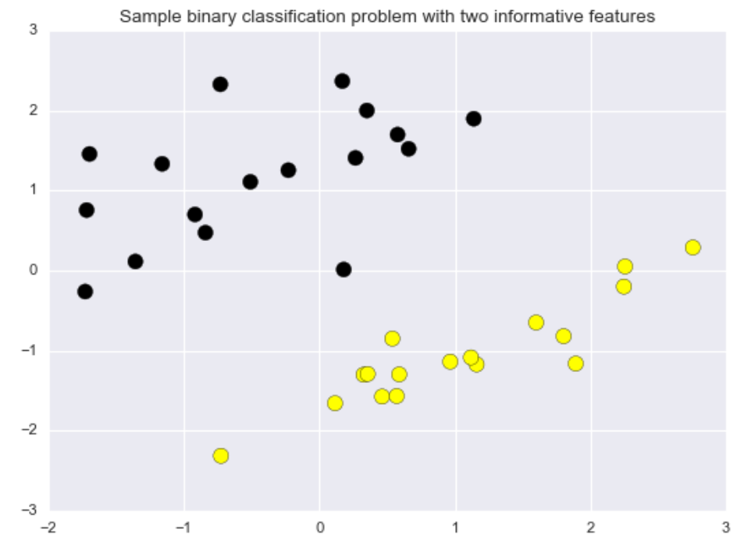
Linear classifiers: how would you separate these two groups of training examples with a straight line?
Feature
vector
Class value
$$x$$
f
$$\hat{y}$$
$$f\left(x,w,b\right)=sign\left(w∘x+b\right)$$
$=sign (\sum{w\left[i\right]x[i]}$ + b)

Slide 5
Linear Classifiers
$$x$$
f
$$\hat{y}$$
$$f\left(x,w,b\right)=sign(w∘x+b)$$
There are many possible linear classifiers that could separate the two classes.
Which one is best?

Slide 6
Maximum margin linear classifier: Linear Support Vector Machines
$$x$$
f
$$\hat{y}$$
$$f\left(x,w,b\right)=sign(w∘x+b)$$
Margin: maximum decision boundary widgth before hitting a data point.
Linear Support Vector Machine (LSVM) is the maximum margin classifier.

Slide 7



Maximum margin linear classifier: Linear Support Vector Machines
$$x$$
f
$$\hat{y}$$
$$f\left(x,w,b\right)=sign(w∘x+b)$$
Support Vectors: points that define maximum margin

Slide 8
Why maximum margin?
Intuitively "safest"
If we’ve made a small error in the location of the boundary (it’s been jolted in its perpendicular direction) this gives us least chance of causing a misclassification.
Empirically it works very well.
LOOCV is easy since the model is immune to removal of any non-support-vector datapoints.
Intuitively does dimension reduction
$$x$$
f
$$\hat{y}$$
$$f\left(x,w,b\right)=sign(w∘x+b)$$
AM
Notes:
LOOCV = leave one out cross validation

Slide 9
Specifying a line and margin
Classifier Boundary
How do we represent this mathematically?
…in m input dimensions?
AM

Slide 10
Specifying a line and margin
Plus-Plane
“Predict Class = +1” zone
Classifier Boundary
Minus-Plane
“Predict Class = -1” zone
Plus-plane = { x : w · x + b = +1 }
Minus-plane = { x : w · x + b = -1 }
Classify as.. | +1 | if | w · x + b >= 1
 | -1 | if | w · x + b <= -1
 | Whatever | if | -1 < w · x + b < 1
AM

Slide 11
Our goal is to find the line with maximum margin width M, so we must be able to compute M
M = Margin Width
“Predict Class = +1” zone
“Predict Class = -1” zone
wx+b=1
wx+b=0
Plus-plane = { x : w · x + b = +1 }
Minus-plane = { x : w · x + b = -1 }
wx+b=-1
How do we compute M in terms of w and b?
AM

Slide 12

Our goal is to find the line with maximum margin width M, so we must be able to compute M
M = Margin Width
“Predict Class = +1” zone
“Predict Class = -1” zone
wx+b=1
wx+b=0
Plus-plane = { x : w · x + b = +1 }
Minus-plane = { x : w · x + b = -1 }
wx+b=-1
After some linear algebra using our constraints
M = Margin Width = $\frac{2}{\sqrt{w∙w}}$
AM
Notes:
Intuition: if w is big, then a small increase in x will push it so that wx+b = 1 boundary, therefore M is small.

Slide 13
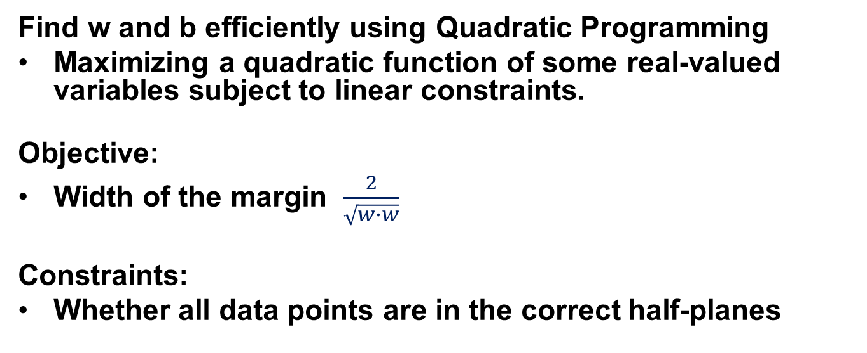
Optimization
Find w and b efficiently using Quadratic Programming
Maximizing a quadratic function of some real-valued variables subject to linear constraints.
Objective:
Width of the margin $\frac{2}{\sqrt{w∙w}}$
Constraints:
Whether all data points are in the correct half-planes
AM

Slide 14
Quadratic criterion
Find
Subject to
n additional linear inequality constraints
And subject to
additional linear equality constraints
Notes:
How do you deal with the fact that quadratic is in denominator.

Slide 15
What quadratic objective should we really minimize?
denotes +1
denotes -1
Minimize
w·w ?

Slide 16
What quadratic objective should we really minimize?
denotes +1
denotes -1
Minimize
w·w + C (distance of error
points to their
correct place)

Slide 17
Regularization for SVMs: the C parameter
C: strength of regularization
Larger C: less regularization
Prioritize pointwise classification correctness over large margin
Smaller C: more regularization
Prioritize large margin over pointwise classification correctness

Slide 18
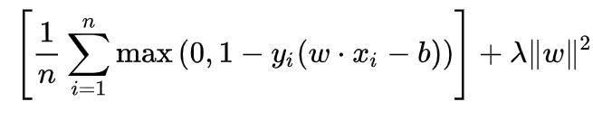

Actually…
SVMs can be seen as Empirical Risk Minimization
Use Hinge Loss with L2 regularization
Here $λ=\frac{1}{c}$

Slide 19
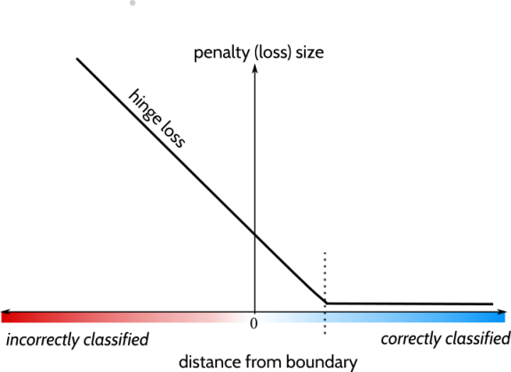
Hinge Loss
1
1

Slide 20



Review
L2 regularization with
Square-loss
Log loss
Hinge loss
Ridge Regression, Logistic Regression, SVM

Slide 21
Think, Pair, Share
The SVM’s boundary will change if you:
Add many items that are clearly correctly classified
Add many items that are clearly misclassified
Both of the Above
None of the Above

Slide 22
Linear SVMs
Features
Must relate linearly
Must normalize
Parameters
Regularization
Evaluation
Usual
Coefficients are interpretable

Slide 23
Linear Models: Pros and Cons
Pros:
Simple and easy to train.
Fast prediction.
Scales well to very large datasets.
Works well with sparse data.
Reasons for prediction are relatively easy to interpret.
Cons:
For lower-dimensional data, other models may have superior generalization performance.
For classification, data may not be linearly separable (more on this in SVMs with non-linear kernels)

Slide 24
Kernelized Support Vector Machines

Slide 25
We saw how linear support vector classifiers could effectively find a decision boundary with maximum margin
Easy for a linear classifier

Slide 26
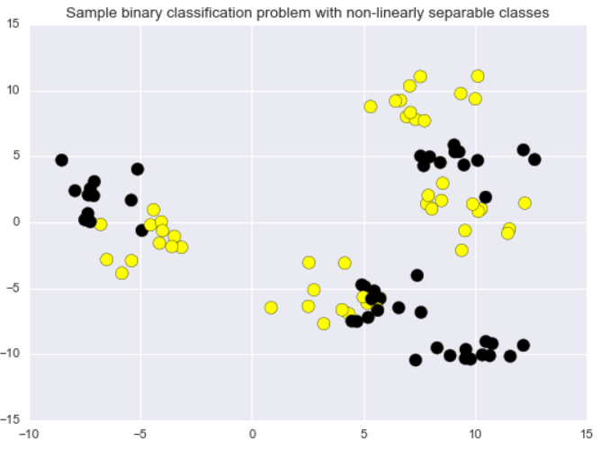
But what about more complex binary classification problems?
Easy for a linear classifier
Difficult/impossible for a linear classifier

Slide 27
A simple 1-dimensional classification problem for a linear classifier
x = 0

Slide 28
A more perplexing 1-d classification problem for a linear classifier

Slide 29
A more perplexing 1-d classification problem for a linear classifier
x
x = 0

Slide 30
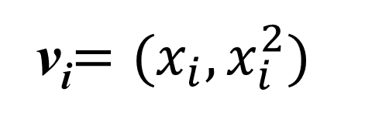
Let's transform the data by adding a second dimension/feature (set to the squared value of the first feature)
v_{i}$=(x_{i}, x_{i}^{2})$
x
x = 0

Slide 31
The data transformation makes it possible to solve this with a linear classifier
v_{i}$=(x_{i}, x_{i}^{2})$
x

Slide 32
What does the linear decision boundary in feature space correspond to in the original input space?
Original input space
Feature space
x
x

Slide 33
What does the linear decision boundary correspond to in the original input space?
What does this remind you of?
Original input space
Feature space
x
x

Slide 34
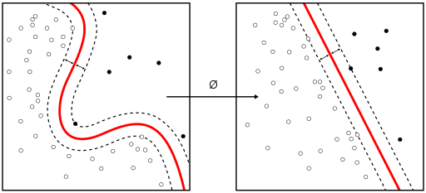
Transforming the data can make it much easier for a linear classifier.
Original input space
Feature space
Source: Wikipedia "Kernel Machine" article. https://commons.wikimedia.org/w/index.php?curid=47868867

Slide 35
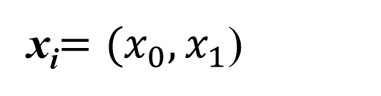
Example of mapping a 2D classification problem to a 3D feature space to make it linearly separable
Original input space
x_{i}$=(x_{0}, x_{1}$)

Slide 36
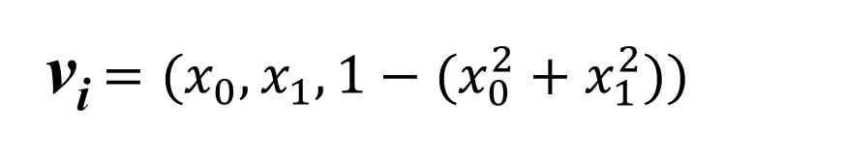
Example of mapping a 2D classification problem to a 3D feature space to make it linearly separable
Feature space
Original input space
x_{i}$=(x_{0}, x_{1}$)
v_{i}$=(x_{0}, x_{1},1−{(x}_{0}^{2} +{ x}_{1}^{2}))$

Slide 37
Example of mapping a 2D classification problem to a 3D feature space to make it linearly separable
Feature space
Original input space
x_{i}$=(x_{0}, x_{1}$)
v_{i}$=(x_{0}, x_{1},1−{(x}_{0}^{2} +{ x}_{1}^{2}))$

Slide 38
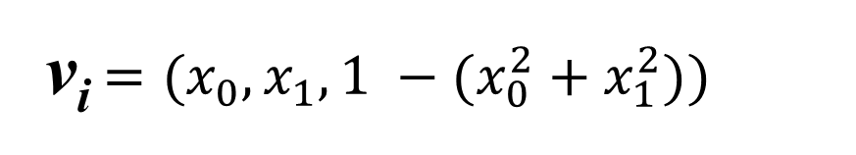
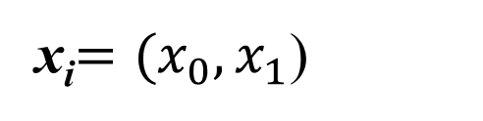
Example of mapping a 2D classification problem to a 3D feature space to make it linearly separable
Feature space
Original input space
v_{i}$=(x_{0}, x_{1},1 −{(x}_{0}^{2} +{ x}_{1}^{2}))$
x_{i}$=(x_{0}, x_{1}$)

Slide 39
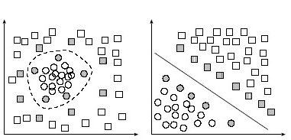
Radial Basis Function Kernel
$$K(x, x^{′})=\exp{ [−γ{⋅\left\|x−x^{′}\right\|}^{2}]}$$
Original input space
Feature space
A kernel is a similarity measure (modified dot product) between data points

Slide 40
Common SVM basis functions
z_{k} = ( polynomial terms of x_{k} of degree 1 to q )
z_{k} = ( radial basis functions of x_{k} )
z_{k} = ( sigmoid functions of x_{k} )

Slide 41
SVM Kernel Functions
K(a,b)=(a · b +1)^{d} is an example of an SVM Kernel Function
Beyond polynomials there are other very high dimensional basis functions that can be made practical by finding the right Kernel Function
Radial-Basis-style Kernel Function:
Neural-net-style Kernel Function:
σ, κ and δ are magic parameters that must be chosen by a model selection method such as CV

Slide 42
Radial basis function
A real-valued function φ_{c}(x) whose value depends on the distance of x from some center point c.

Slide 43
1-d RBFs
y
c₁
c₂
c₃
x
y^{est} = β₁ φ₁(x) + β₂ φ₂(x) + β₃ φ₃(x)
where
φ_{i}(x) = KernelFunction( | x - c_{i} | / KW)
Informally, the representation of point x is transformed
to a set of distances from center points

Slide 44
Radial Basis Functions (RBFs)
X₁ | X₂ | Y
3 | 2 | 7
1 | 1 | 3
: | : | :
X=
y=
3 | 2
1 | 1
: | :
7
3
:
x₁=(3,2)..
y₁=7..
… | … | … | … | … | …
… | … | … | … | … | …
… | … | … | … | … | …
7
3
:
y=
Z=
β = (Z^{T}Z)⁻¹(Z^{T}y)
y^{est} = β₀+
β₁ x₁+…
z=(list of radial basis function evaluations)

Slide 45
Example
y
c₁
c₂
c₃
x
y^{est} = 2φ₁(x) + 0.05 φ₂(x) + 0.5 φ₃(x)
where
φ_{i}(x) = KernelFunction( | x - c_{i} | / KW)

Slide 46
RBFs with Linear Regression
y
c₁
c₂
c₃
x
y^{est} = 2φ₁(x) + 0.05 φ₂(x) + 0.5 φ₃(x)
where
φ_{i}(x) = KernelFunction( | x - c_{i} | / KW)

Slide 47
RBFs with Linear Regression
y
KW also held constant (initialized to be large enough that there’s decent overlap between basis functions*
*Usually much better than the bad overlap on this diagram
c₁
c₁
c₁
All c_{i} ’s are held constant (initialized randomly or on a grid in m-dimensional input space)
x
y^{est} = 2φ₁(x) + 0.05 φ₂(x) + 0.5 φ₃(x)
where
φ_{i}(x) = KernelFunction( | x - c_{i} | / KW)

Slide 48
RBFs with Linear Regression
y
KW also held constant (initialized to be large enough that there’s decent overlap between basis functions*
*Usually much better than the bad overlap on this diagram
c₁
c₁
c₁
All c_{i} ’s are held constant (initialized randomly or on a grid in m-dimensional input space)
x
y^{est} = 2φ₁(x) + 0.05 φ₂(x) + 0.5 φ₃(x)
where
φ_{i}(x) = KernelFunction( | x - c_{i} | / KW)
Then given Q basis functions, define the matrix Z such that
Z_{kj} = KernelFunction( | x_{k} - c_{i} | / KW)
where x_{k} is the k-th vector of inputs
And as before, β = (Z^{T}Z)⁻¹(Z^{T}y)

Slide 49
RBFs with Linear Regression
y
KW also held constant (initialized to be large enough that there’s decent overlap between basis functions*
*Usually much better than the bad overlap on this diagram
c₁
c₁
c₁
All c_{i} ’s are held constant (initialized randomly or on a grid in m-dimensional input space)
x
y^{est} = 2φ₁(x) + 0.05 φ₂(x) + 0.5 φ₃(x)
where
φ_{i}(x) = KernelFunction( | x - c_{i} | / KW)
But how do we now find all the β_{j}’s, c_{i} ’s and KW ?

Slide 50
RBFs with Linear Regression
y
KW also held constant (initialized to be large enough that there’s decent overlap between basis functions*
*Usually much better than the bad overlap on this diagram
c₁
c₁
c₁
All c_{i} ’s are held constant (initialized randomly or on a grid in m-dimensional input space)
x
y^{est} = 2φ₁(x) + 0.05 φ₂(x) + 0.5 φ₃(x)
where
φ_{i}(x) = KernelFunction( | x - c_{i} | / KW)
But how do we now find all the β_{j}’s, c_{i} ’s and KW ?
Answer: Gradient descent

Slide 51
Radial Basis Functions in 2-d
Two inputs.
Outputs (heights sticking out of page) not shown.
Center
Sphere of significant influence of center
x₂
x₁

Slide 52
Happy RBFs in 2-d
Blue dots denote coordinates of input vectors
Center
Sphere of significant influence of center
x₂
x₁

Slide 53
Grumpy RBFs in 2-d
Blue dots denote coordinates of input vectors
What’s the problem in this example?
Center
Sphere of significant influence of center
x₂
x₁

Slide 54
More grumpy RBFs
And what’s the problem in this example?
Blue dots denote coordinates of input vectors
Center
Sphere of significant influence of center
x₂
x₁

Slide 55
Hopeless!
Center
Even before seeing the data, you should understand that this is a disaster!
Sphere of significant influence of center
x₂
x₁

Slide 56
Unhappy
Center
Even before seeing the data, you should understand that this isn’t good either..
Sphere of significant influence of center
x₂
x₁

Slide 57
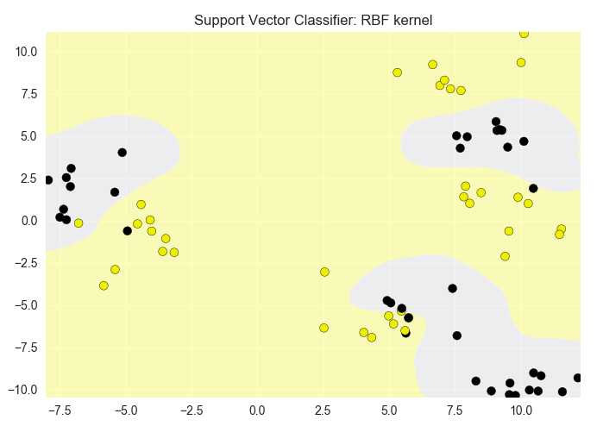
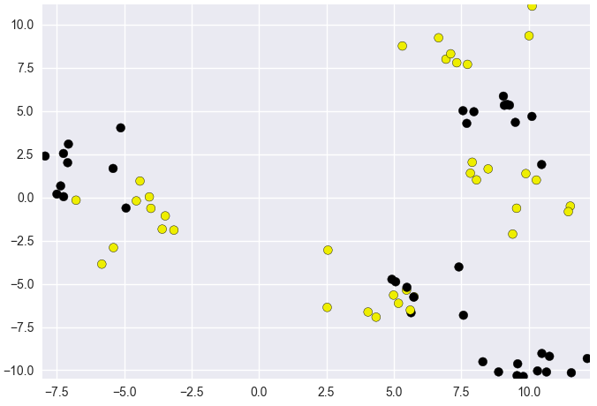
Applying the SVM with RBF kernel

Slide 58
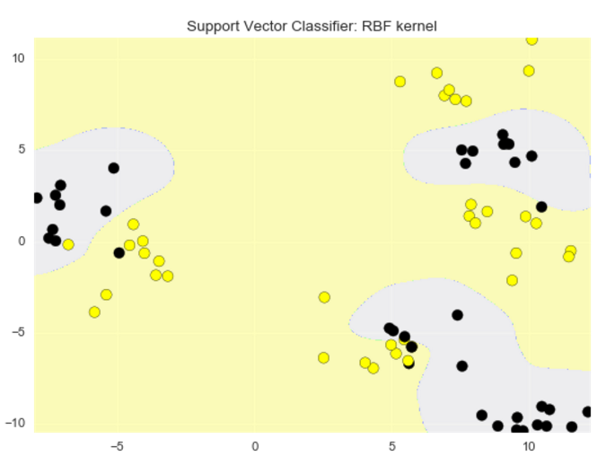
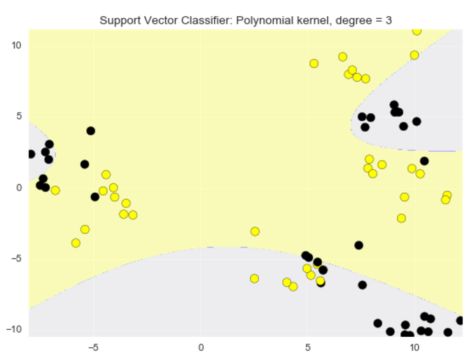
Radial Basis Kernel vs Polynomial Kernel

Slide 59

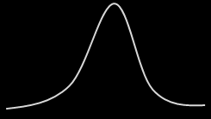
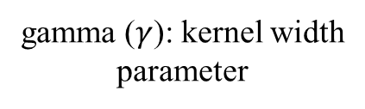

Radial Basis Function kernel: Gamma Parameter
small gamma (0.01)
large gamma (10)
$$K(x, x^{′})=\exp{ [−γ⋅{\left\|x−x^{′}\right\|}^{2}]}$$
1
1
gamma ($γ$): kernel width parameter
0
0
$${\left\|x−x^{′}\right\|}^{2}$$
Squared distance
between x and x'

Slide 60
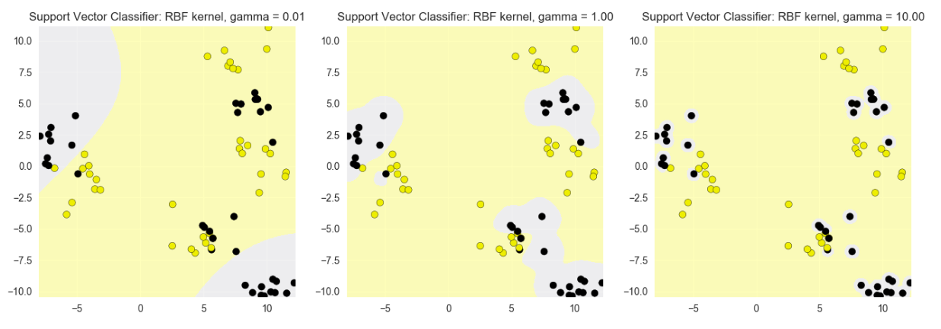
The effect of the RBF gamma parameter on decision boundaries
gamma = 0.01
gamma = 1.0
gamma = 10

Slide 61
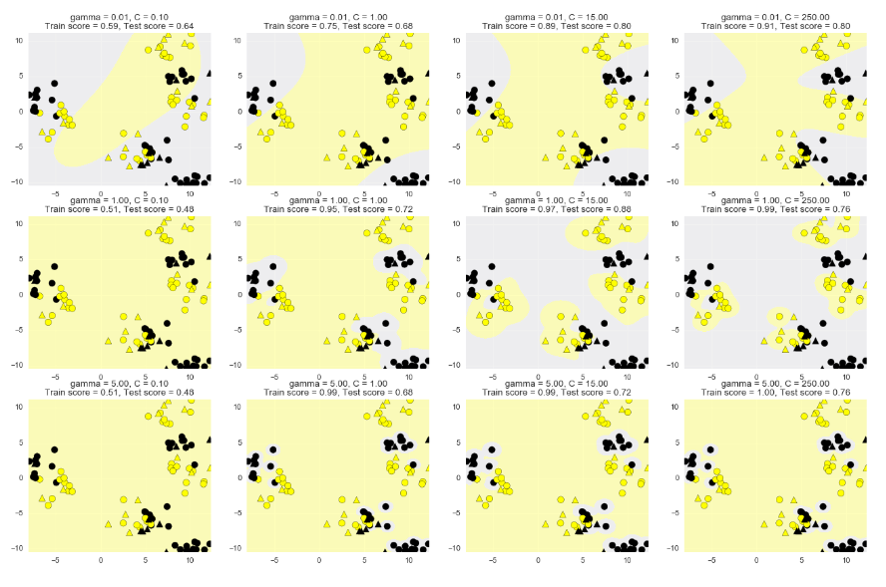
Increasing gamma
Increasing C
Notes:
Underfitting upper left. Overfitting lower right.

Slide 62
Reminder: Using a scaler object: fit and transform methods
from sklearn.preprocessing import MinMaxScaler
scaler = MinMaxScaler()
scaler.fit(X_train)
X_train_scaled = scaler.transform(X_train)
X_test_scaled = scaler.transform(X_test)
clf = SVC().fit(X_train_scaled, y_train)
accuracy = clf.score(X_test_scaled, y_test)
Tip: It can be more efficient to do fitting and transforming together on the training set using the fit_transform method.
scaler = MinMaxScaler()
X_train_scaled = scaler.fit_transform(X_train)

Slide 63
Kernelized Support Vector Machines: pros and cons
Pros:
Can perform well on a range of datasets.
Versatile: different kernel functions can be specified, or custom kernels can be defined for specific data types.
Works well for both low- and high-dimensional data.
Cons:
Efficiency (runtime speed and memory usage) decreases as training set size increases (e.g. over 50000 samples).
Needs careful normalization of input data and parameter tuning.
Does not provide direct probability estimates (but can be estimated using e.g. Platt scaling).
Difficult to interpret why a prediction was made.

Slide 64
Kernalized SVMs
Features
Must relate locally
Must normalize
Parameters
Next slides
Evaluation
Usual
Coefficients are not very interpretable

Slide 65
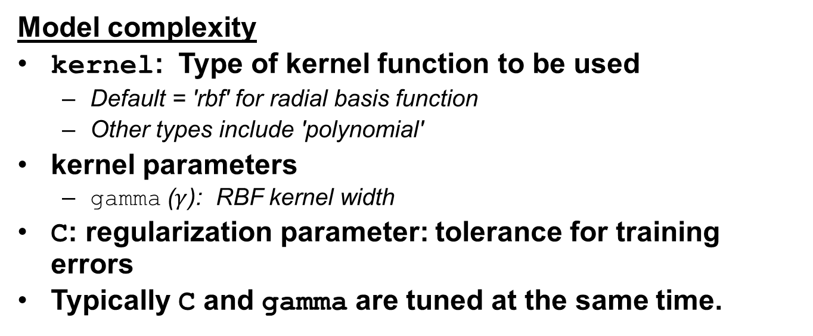
Kernelized Support Vector Machines (SVC): Important parameters
Model complexity
kernel: Type of kernel function to be used
Default = 'rbf' for radial basis function
Other types include 'polynomial'
kernel parameters
gamma ($γ$): RBF kernel width
C: regularization parameter: tolerance for training errors
Typically C and gamma are tuned at the same time.

Slide 66
Support Vector Regression

Slide 67
Can the maximum margin principle be used for regression?

Slide 68
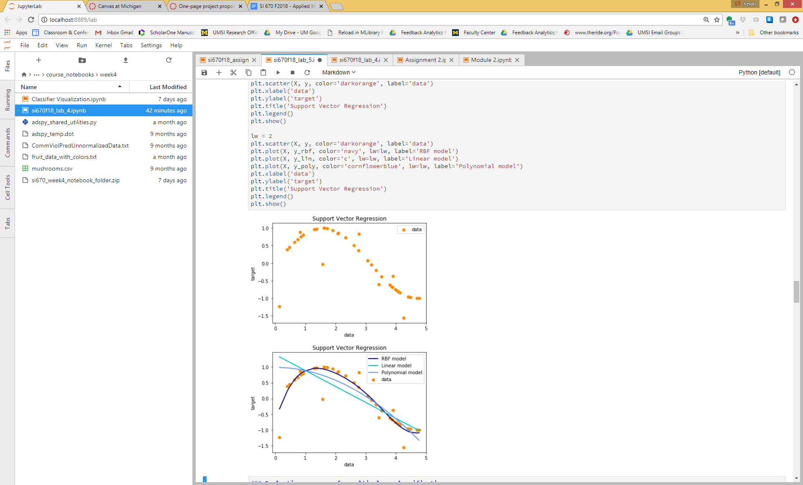
Yes! Support Vector Regression

Slide 70
SVM Regression
Ideal:
Minimize band so that all data within band.
Actual:
Add some error for points outside band.

Slide 71
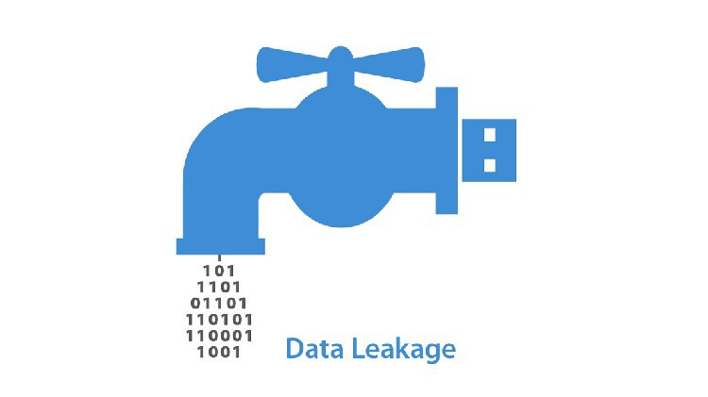
Data Leakage

Slide 72
Data Leakage
Features contains illicit information about the target.
not available during actual use.
Obvious example: label to be predicted included as a feature
Training data contains illicit information about test data
Including test data with training data
If your model performance is too good to be true, it probably is and likely due to "giveaway" features.
Notes:
data_leakage_summary

Slide 73
More subtle examples of illicit features
Target: will user stay on a site, or leave?
Giveaway feature: total session length
based on information about future page visits
Target: will user open an account?
Giveaway feature: account number field
only filled in once the user does open an account.
Diagnostic medical test
Giveaway feature: whether they had surgery for tested condition.
The patient ID could contain information about specific diagnosis paths (e.g. for routine visit vs specialist).
Giveaway features are highly predictive, but not available for the prediction
Notes:
Data_leakage_past_future_example

Slide 74
More subtle examples of illicit features
Leakage in features:
Removing illicit variables but leaving others that encode related information (e.g. diagnosis info may still exist in patient ID).
Implicitly reversing intentional randomization / anonymization
Above problems when extra data is added:
external data joined to the training set.
Time-series datasets: using records from the future when computing features for the current prediction.
Errors in data values/gathering or missing variable indicators (e.g. the special value 999) can encode information about missing data that reveals information about the future.
Notes:
Data_leakage_forms

Slide 75
Illicit training
Data preprocessing using parameters or results from analyzing the entire dataset:
Normalizing and rescaling,
detecting and removing outliers,
estimating missing values,
feature selection,
cross-validation.
Perform data preparation and hyper-parameter tuning within each cross-validation fold separately
Notes:
Data_leakage_forms

Slide 76
Detecting data leakage
Think!
Before building the model
Exploratory data analysis to find surprises in the data
Are unexpected features highly correlated with the target?
After building the model
Look for surprising feature behavior in the fitted model.
high weights, (or high information gain)
Is overall model performance surprisingly good?
compare to known results on the same/similar datasets
Example: Coupon Detection
(Limited) real-world deployment of the trained model
Do results generalize?
Notes:
Data_leakage_detection

Slide 77
Minimizing Data Leakage
Perform data preparation and hyper-parameter tuning within each cross-validation fold separately
With time series data, use a timestamp cutoff
Before any work with a new dataset, split off a final test dataset
… if you have enough data
Use this final test dataset as the very last step in your validation
Helps to check the true generalization performance of any trained models
Notes:
Data_leakage_minimization

Slide 78

Missing Data
Well the two men took to fighting And when they pulled them off the floor Leroy looked like a jigsaw puzzle With a couple of pieces gone.

Slide 79
Imputing missing data
How to handle missing data?
Data will be missing!
No Silver Bullet
For categories, create “unknown” category.
Can create missing dummy variable for numerical values.
Otherwise
can discard data
can “learn” missing value.

Slide 80
“Learning” Missing values
Can use a Dummy Regressor to learn:
Replace with average
Replace with constant
More sophisticated single imputation:
Less common
Ordinary Least Squares
K-NN
choose randomly?
From a posterior distribution
Multiple imputation:
Impute all incomplete features at the same time.

Slide 81
More on Missing Features
Censorship: Missing data depends on values
Cannot just remove data
Replacing with average not great
Time series data:
Often other approaches to take
Less important in ML than statistics
Better imputation will improve prediction
Do not have to worry about confidences
Still implications for fairness

Slide 82
Optimizing Classifiers for Different Evaluation Metrics

Slide 83
Certain functions (parameter search) can take an evaluation metric as a parameter
clf = Logistic(C=100.0).fit(X_twovar_train, y_train)
grid_values = {'class_weight':['balanced', {1:2},{1:3},{1:4},{1:5},{1:10},{1:20},{1:50}]}
plt.figure(figsize=(10,7))
for i, eval_metric in enumerate(('precision','recall', 'f1','roc_auc')):
grid_clf_custom = GridSearchCV(clf, param_grid=grid_values, scoring=eval_metric)
grid_clf_custom.fit(X_twovar_train, y_train)
... etc

Slide 84
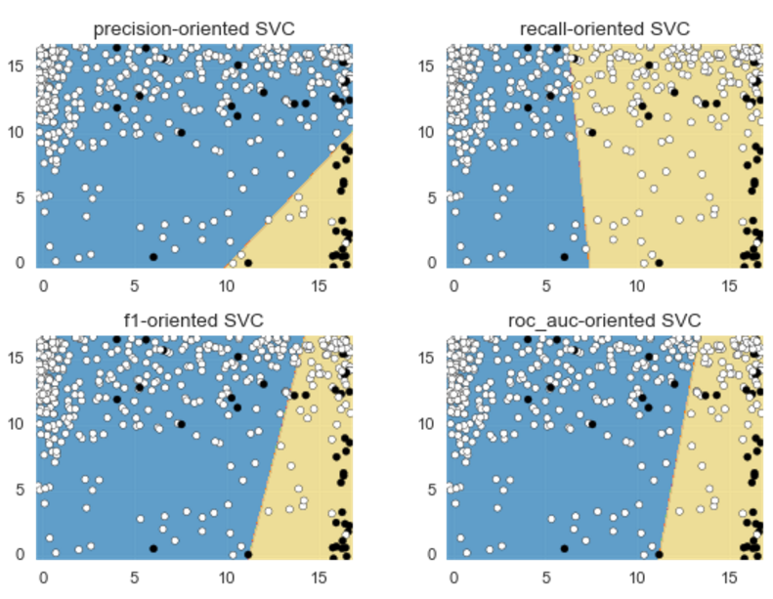
Example: Optimizing a Classifier Using Different Evaluation Metrics
Notes:
Example_svc_optimized

Slide 85
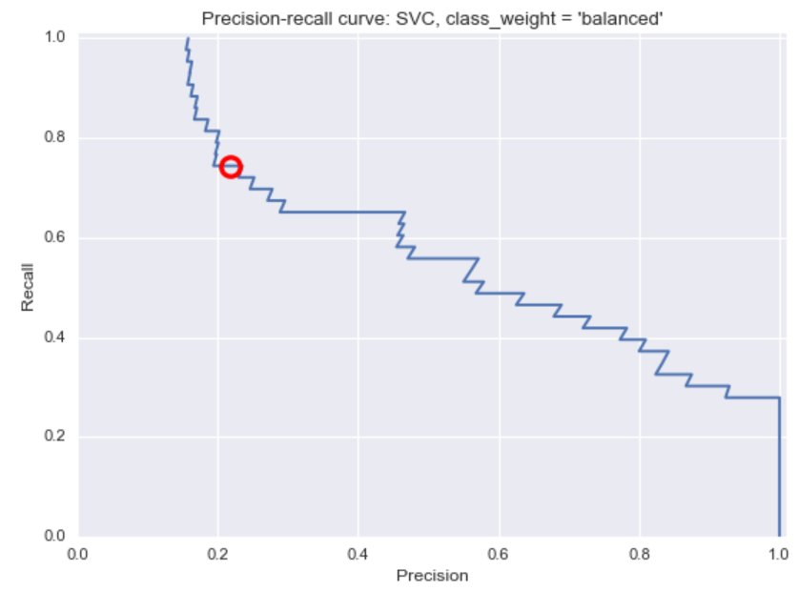
Example: Precision-Recall Curve of Default Support Vector Classifier
Notes:
Example_PR_Curve

Slide 86
Regression to the Mean

Slide 87
Thought Experiment I
Each person in this class gets a die.
Each die:
Has six sides.
Each side contains some number 1-6.
Each number may appear more than once.
We all role the dice 10 times.
The winning die is the die with the greatest sum of its rolls.
Let H be this sum on the winning die.
Roll the winning die 10 more bonus times, let B be their sum.
Do we expect:
A) It is more likely that H > B
B) It is more likely that B < H
C) The above are equally likely.

Slide 88
Thought Experiment II
Each person in this class gets a die.
Each die:
Has six sides with the numbers 1-6 appearing, one per side. We all role the dice 10 times.
The winning die is the die with the greatest sum of its rolls.
Let H be this sum on the winning die.
Roll the winning die 10 more bonus times, let B be their sum.
Do we expect:
A) It is more likely that H > B
B) It is more likely that B < H
C) The above are equally likely.

Slide 89
Thought Experiment III
Each person in this class gets a die.
Each die:
Has six sides.
Sum of all the sides is a number between 1 and 120
Each die has as different sum
The winning die is the die with the greatest sum of its rolls.
Let H be this sum on the winning die.
Roll the winning die 10 more bonus times, let B be their sum.
Do we expect:
A) It is more likely that H > B
B) It is more likely that B < H
C) The above are equally likely.

Slide 90
Thought Experiment III
Each person in this class comes submits hyper parameters for SVM with RBF.
We use cross validation to train each model.
The winning model is the one with the highest average test accuracy.
Let H be this accuracy.
We test the winning parameters on a completely new set of data and find it has accuracy B.
Do we expect:
A) It is more likely that H > B
B) It is more likely that B < H
C) The above are equally likely.

Slide 91
Regression to the Mean
After selecting for an extreme event:
Likely detecting noise AND signal.
Part of the reason for selection is signal.
Part of the reason for selection is noise.
When it is rerun, new noise is drawn.
Selecting Faculty/Employees for Promotion
Punishing Poor Performance
Selecting over Hyper-parameters!

Slide 92
Training, Validation, and Test Framework for Model Selection and Evaluation
Using only cross-validation or a test set to do model selection may lead to more subtle overfitting / optimistic generalization estimates
Notes:
Train_validation_test

Slide 93
How Many Splits Do You Need?

Slide 94
Training, Validation, and Test Framework for Model Selection and Evaluation
Three data splits:
1. Training set (model building)
2. Validation set (model selection—tune parameters, but never fit models)
3. Test set (final evaluation)
Notes:
Train_validation_test

Slide 95
Training, Validation, and Test Framework for Model Selection and Evaluation
In practice:
Create an initial training/test split
Do cross-validation on the training data for model/parameter selection
Save the held-out test set for final model evaluation
Notes:
Train_validation_test

Slide 96
Case 1
You have 10 different algorithms to test. You want to discover the best algorithm. You use your labeled data to run cross validation on each algorithm. You determine that algorithm with the highest average score is most likely to be the best.
Did you do anything wrong?
A) Yes, you should have divided your training data in to training and test data.
B) No, what could have gone wrong?
Notes:
Train_validation_test

Slide 97
Case 2
You have 10 different algorithms to test. You want to discover the accuracy of the best algorithm. You use your labeled data to run cross validation on each algorithm. You return the accuracy of the highest algorithm.
Did you do anything wrong?
A) Yes, you should have divided your training data in to training and test data.
B) No, what could have gone wrong?
Notes:
Train_validation_test

Slide 98
TO DO
Add examples on regression to mean.
Talk about different types of splitting.
Think about SV regression.
Think Pair Share:
Correctly Classified Points Far from the boundary do not impact classifier
Incorrectly…
All / Neither of the above.

